Slide 1
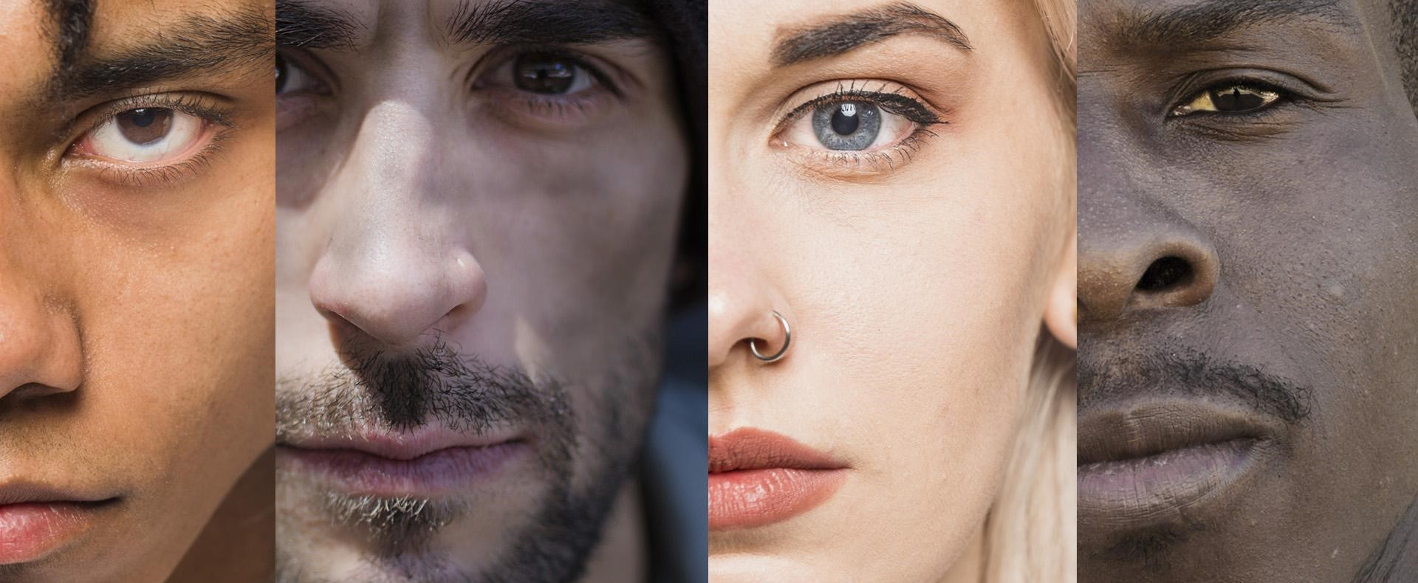
Trauma-Informed Care and Cultural Responsiveness Through Justice Doing

Slide 2
Facilitator Introductions
Anisa Mustafa
Vanessa Williams
Vanessa Williams (she/her) is a state-certified peer support specialist, trainer, mental health advocate, CEO, and founder of Elevate Recovery. She specializes in aiding individuals and organizations to use diversity, equity, inclusion, and belonging in their workplace culture for increased productivity and employee retention. Vanessa’s areas of expertise include peer support leadership, mentoring, and coaching from a trauma-informed perspective.
Anisa Mustafa (they/she) lives on the lands of Doeg and Piscataway Peoples in Northern Virginia with their two cats, Bobbie and JJ. They are a Certified Peer Recovery Specialist in the Commonwealth of Virginia and the Director of Training for One New Heartbeat, a grassroots organization in Northern California. They are a lifelong learner dedicated to serving their community within a trauma-informed, culturally responsive and social justice framework that promotes diversity, equity, and accessibility for all.

Slide 3
Objectives
Objective 1
Participants will be able to integrate and apply the concepts of intersectionality, power, privilege and oppression as a basis for a trauma-informed and culturally responsive approach.
Objective 3
Participants will be able to identify and distinguish between the four culturally informed components of being culturally responsive.
Objective 4
Objective 2
Participants will acquire four key trauma-informed and culturally responsive strategies for working with individuals living with and healing from trauma.
Participants will acquire an understanding of the principles of “justice doing” and how to apply them in their communities.

Slide 4
Justice-Doing
Justice-Doing is a collaborative framework created by Vikki Reynolds, Ph.D.
There are many pathways to practicing justice-doing.
It is a practice that aligns with our collective commitments to social justice.
“Our work occurs in contexts that lack social justice because we have not delivered on a just society. The issues of mental illness, addiction, and trauma are medicalized and sanitized in language that hides human suffering and affronts to dignity. As workers and clients, we are collectively up against the privatization of pain and the criminalization of suffering, such as the criminalization of homelessness, poverty, and dissent.”¹ –Vikki Reynolds
It is an approach informed by decolonizing practice and anti-oppression activism.
It is transformative for ourselves, the people we work alongside, our communities and society.
It outlines how to impact social change in community work by relying on six guiding principles to ground the work that we do.

Slide 5
The Six Guiding Principles of Justice-Doing…¹
Centering Ethics
‘Our personal and relational ethics are at the centre of how I approach supervision and training. As practitioners responding to clients’ varying needs, if we act in alignment with our collective ethics, then we have a positive impact on our community work and the entire field.’
Doing Solidarity
‘Doing Solidarity means that we see all of our work as interconnected and that we act collectively to promote social justice and resist oppression. This concept evolved from the activist practice of looking for points of connection and bringing people together to create community.’
Addressing Power
‘Addressing Power requires identifying injustices and taking positions that address abuses of power. It includes witnessing peoples’ resistance to oppression, and it invites creating practices of cultural and collective accountability.’
Notes:
What are the principles that you

Slide 6
The Six Guiding Principles of Justice-Doing Continued¹
Fostering Sustainability
‘We foster sustainability collectively by having a genuine connectedness with others and a spirited engagement with our work. This encompasses the capacity to experience ourselves as being of genuine use to clients with an openness to our transformations across time.’
Engaging with Language
‘Language is a powerful tool used to resist or serve abuses of power, so I hold an overt intention of utilizing language in liberalizing ways. Critically engaging with language also recognizes the language of the body and acknowledges the intricate communications that happen over and beyond the use of words.’
Structuring Safety
‘All conversations across difference are risky, and the possibility of doing harm by replicating oppression is one potential risk. Structuring Safety creates practices that invite safety into our work; informs us to act as allies where we are privileged; and to honor accountability and collaboration.’
Notes:
What are the principles that you

Slide 7
Breakout Group Activity
Prompts
What does this principle of justice-doing mean to me?
How can I ground myself and my work in this principle of justice-doing?
Breakouts
Breakout Group 1 → Centering Ethics
Breakout Group 2 → Doing Solidarity
Breakout Group 3 → Addressing Power
Breakout Group 4 → Fostering Sustainability
Breakout Group 5 → Engaging with Language
Breakout Group 6 → Fostering Safety
© 2023 A. Mustafa & V. Williams

Slide 8
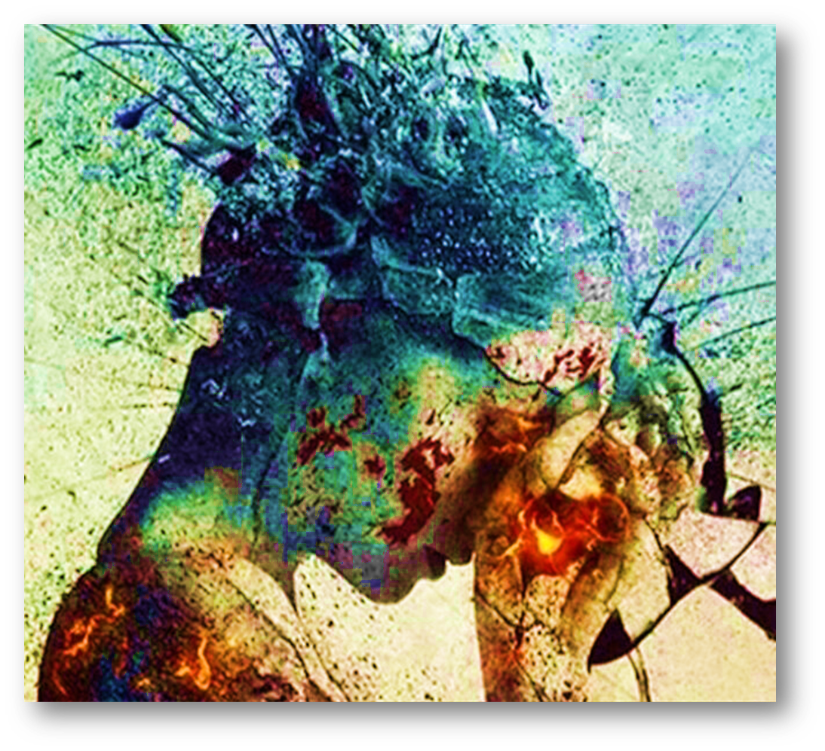
Trauma
An event, a series of events or set of circumstances that can occur over extended periods of time that are harmful to an individual and may have lasting effects on that individual’s physical, mental, emotional and/or spiritual well-being. These effects can manifest over the course of the individual’s life and vary in severity and form. These effects are a natural response to the harmful events or circumstances, which are usually abnormal.²

Slide 9
SAMHSA’s The Three E’s of Trauma¹
EVENT:
EXPERIENCE:
EFFECTS:
The possible lasting change in actions, emotions and/or worldviews resulting from the experience of the event (i.e., adaptations to deal with the experience). The how of the trauma.
The inner perception and processing of the event or circumstances in combination with external supports. The why of the trauma.
An external event that triggers the body’s fight, flight, freeze, fawn, etc. response. The episode may occur once or, over a period, multiple times. The who, what, where and when of the trauma.
Notes:
Event: who, what, when and where
Experience: why
Effect: how

Slide 10
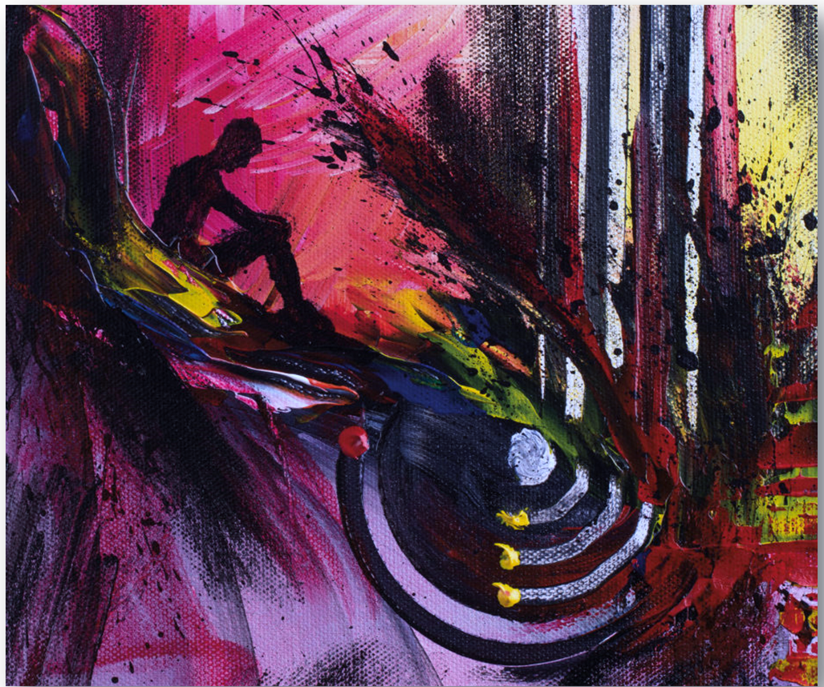
Why It’s Not the Event: Emotional Trauma
Psychological and/or emotional trauma may be the internal experience and potential lasting imprint on an individual’s physical, mental, emotional and/or spiritual well-being following a traumatic event, series of events or set of circumstances. This might be a disconnection from self or others or a change in actions, mood, etc.
It is not necessarily the magnitude of the event, series of events or set of circumstances that determine the level of traumatization, but rather it might be the situational perception, internal process that the individual experiences and the quality of external supports that make this determination.

Slide 11
The experience of trauma is unique to everyone because…
Breakout Group Activity
Notes:
Individuals are Unique
Experiences Differ
Family of Origin
Race & Ethnicity
Culture
Language
Socioeconomic Status
Geographic Location
Resiliency Factors
Exposure to Trauma
Heredity
Support Systems (friends/family)
Societal Supports (community/systems)
Perception of the Trauma

Slide 12
Trauma and the Individual
The experience of trauma is unique to everyone because…
Individuals are Unique
Experiences Differ
Family of Origin
Race & Ethnicity
Cultures and Subcultures of Belonging
Language
Socioeconomic Status
Geographic Location
Resiliency
Exposure to Previous Trauma
Heredity
Support Systems (friends/family)
Societal Supports (community/systems)
Perception of the Trauma

Slide 13
Intersectionality
First coined by Professor Kimberlé Crenshaw in 1989.
Intersectionality is a concept that acknowledges all experiences of oppression, discrimination, power and privilege are linked through the interrelated nature of social groupings (e.g., race, socio-economic class, level of education, ethnicity, orientation, ability, etc.). This creates overlapping and interdependent systems of discrimination, disadvantage, advantage and opportunity. Further, it acknowledges that everyone has a unique experience of oppression and power and all factors that may contribute to these experiences need to be examined.

Slide 14
Intersectionality as a Prism on Trauma
Intersectionality is a tool that allows us to think about adversity in a broad context and emphasizes individuals’ experiences to understand the complexity of how individuals experience privilege, power and oppression.
Intersectionality is a prism that when illuminated exposes the full array of spectral colors that constitute the quintessential components of an individual’s unique identity from their perspective and all the shades in between.
It is in the meeting of one’s experience of identity (safety and stability in self and their environment) and how this is acted upon by outside influences (power, privilege and oppression) that traumatic experiences can be seen most clearly.
Trauma is unique and powerful in that it may reshape one’s understanding of their own identity and how one chooses to adapt and respond when acted upon.

Slide 15
Trauma in the Dynamics of Power and Privilege
Power is the ability to make decisions that impact others (e.g., who will access resources) and the capacity to direct or influence the behavior of others, oneself and/or the course of events.
Privilege is an entitlement or an indemnity from liability or obligation given as a special benefit or advantage to a particular population(s) based on perceived social constructs (e.g., race, socio-economic class, level of education, ethnicity, nationality, orientation, ability, etc.).
In this context a more dynamic view of how intersectionality affects traumatic experiences can be cultivated in that privilege and power are given to individuals based on a variety of perceived and real diversity factors.
These benefits will vary from culture to culture, society to society, nation to nation, etc. based on the value systems from which most individuals operate.
Trauma in the form of oppression occurs persistently for those whose intersectionality does not reflect the majority.

Slide 16
Oppression
SYSTEMIC
Systems that operate on policies. practices and other norms that create a hierarchy of one group and benefit from the oppression and exploitation of other groups.
INSTITUTIONAL
Inequities, biases and privileges embedded in institutional cultures, policies, practices and programs in a way that—with or without intent—perpetuate oppression.
INTERPERSONAL
The interaction between individuals—within and across different groups—that are an expression of bias and/or prejudice.
INDIVIDUAL
A person’s beliefs, prejudices, experiences and actions (conscious or unconscious internalized or externalized) that perpetuate and/or are a result of oppression.
Oppression is the result of the use of privilege and power, wherein one person or group benefits at the expense of another.
Oppression exists in various forms and across many levels.
These different forms and levels of oppression interact and shape an individual’s sense of their own power, resilience, and well-being.
Inequity in the distribution of and access to resources affects individuals’ physical, emotional, mental and/or spiritual well-being.
The cumulative effects of trauma interact with other adverse life experiences, impacting the individual’s quality of life.
Traumatic events by their very nature are oppressive by setting up a power differential wherein one force (e.g., an individual, a situation, a system, a force of nature, etc.) has power over the individual being acted upon, eliciting a sense of powerlessness and hopelessness.²

Slide 17
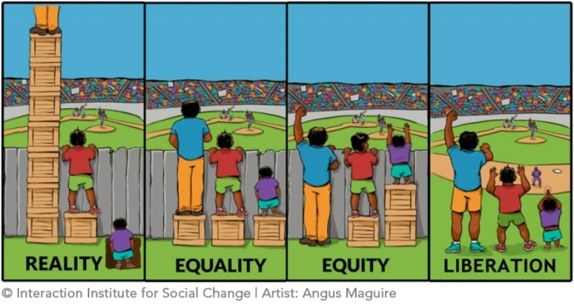

Slide 19
Culturally Responsive Care
Culturally responsive care is the intentional and consistent decision to see, respect, and celebrate the aspects that make each individual unique. It’s an acknowledgment of their intersectional existence in the world and how it shapes their experiences.²
Intentionally consider, without judgment, and engage in pertinent conversations about all aspects of an individual’s experience of life and how it has shaped the person.³
Have strong cross-cultural interpersonal skills³, be self-aware, be self-reflective, actively consider one’s own biases, privilege and power, be open, flexible, curious and willing to grow
Actively engage in anti-oppressive practices, which consider power imbalances to foster an environment that is free from racism, oppression, and other forms of harmful dynamics.³

Slide 20
Culturally Informed Components of Being Culturally Responsive
Cultural Sensitivity
Cultural Awareness
Cultural Humility
Cultural Competence
Putting knowledge and understanding into action, so one can actively operate in different cultural contexts.³
Acknowledgment that one does not have all the answers and is willing to practice ongoing self-evaluation, learn about individual’s experiences and neutralize power imbalances.³
Being open to the idea of shifting one’s own cultural attitudes³ by engaging in an ongoing process of introspection and actively addressing inherent power differences.
Knowing that there are differences between cultures and not assigning a value judgment to those differences.³

Slide 21
Putting it all together: Cultural Responsiveness
Being culturally responsive necessitates having the ability to understand cultural differences, recognize potential biases, and look beyond differences to work productively with children, families, and communities whose cultural contexts are different from one’s own.⁴
Cultural responsiveness enables individuals and organizations to respond respectfully and effectively to people of all cultures, languages, socio-economic backgrounds, races, ethnicities, abilities, religions, genders, sexual orientations, and other diversity factors in a manner that recognizes, affirms, and values their worth.⁴

Slide 22
COPE for Being Trauma-Informed & Culturally Responsive
C
Connection
O
Openness
P
Partnership
E
Engagement

Slide 23
Breakout Groups
Breakout Group 1:
Ways I connect or be in connection with others are…
Breakout Group 2:
Ways I am open or am open with others are…
Breakout Group 3:
Ways I partner or be in partnership with others are…
Breakout Group 4:
Ways I engage or be in engagement with others are…

Slide 24
COPE Being Trauma-Informed & Culturally Responsive
Connection
Creating connections is vital to effective trauma-informed support. Connection involves a multitude of skills including being curious, open, relatable, flexible and authentic. Even in times of disconnection, one can see opportunities for self and relational growth. Connection is a key component of building a strong relationship based on mutuality, respect and safety as both parties have defined it. Connection is an ongoing process.
Openness
Cultivating and nurturing trust is essential when serving those healing from trauma. Honesty, transparency and self-disclosure build rapport and, over time, trust in the relationship. Mutually sharing experiences creates affinity and bonds between individuals. When one is in alignment with mutuality in the relationship the trust is mutual as well. If there is resistance to this, look inward for the cause before looking to others. Being open invites openness.
Partnership
Engagement
Inviting individuals into the process is the essence of partnership. Respecting an individual’s right to dignity of risk and self-directed choice while walking with them on their chosen pathway as a true mutual partner—honoring them and their choices—will foster connection and trust while strengthening the relationship. It is a ‘we’ dynamic that both parties nurture in respect and mutuality. Collaboration and co-creation are key components of partnership.
Engaging the individual on what inspires them, brings them joy and makes them thrive is crucial for understanding and connecting in the moment. Meeting them where they are and sharing one’s own experiences will build trust and foster growth, which is foundational for effective support when working with those living with trauma. Motivational interviewing, active listening and relational support are indispensable tools when engaging.
© 2023 A. Mustafa & V. Williams

Slide 25
Healing & growth from trauma can come from…

Slide 26
Thank You! Be Well On Your Journey!
Today’s experience for me was…
One thing I may want to begin practicing/implementing is…
One thing I may want to do for my own wellness this evening is…

Slide 27
Works Cited
Philosophy that informs my approach to community work. Vikki Reynolds PhD RCC. (2017, December 22). https://vikkireynolds.ca/about-vikki/philosophy/.
SAMHSA’s concept of trauma and guidance for a trauma-informed approach. SAMHSA. (2014, October). https://store.samhsa.gov/sites/default/files/d7/priv/sma14-4884.pdf.
Culturally responsive care in mental health. Lyra Health. (n.d.). Retrieved January 23, 2023, from https://www.lyrahealth.com/resources/culturally-responsive-care/#:~:text=C VASzulturally%20responsive%20care%20is%20the,how%20this%20shapes%20their%20experiences.
Cultural responsiveness. Cultural Responsiveness - Child Welfare Information Gateway. (n.d.). Retrieved January 24, 2023, from https://www.childwelfare.gov/topics/systemwide/cultural/#:~:text=Cultural%20responsiveness%20enables%20individuals%20and,affirms%2C%20and%20values%20their%20worth.

